Slide 1
SC2001 Project 3
Team 8: Jun Meng, Spencer, Kai Xin
P.S: Some slides have notes which contains more info

Slide 2
Table of Contents
1. Recursive Definition of P(C)
2. Subproblem Graph for P(14) with Given Weights and Profits
3. Bottom-Up Dynamic Programming Algorithm
4. Algorithm Implementation in C

Slide 3
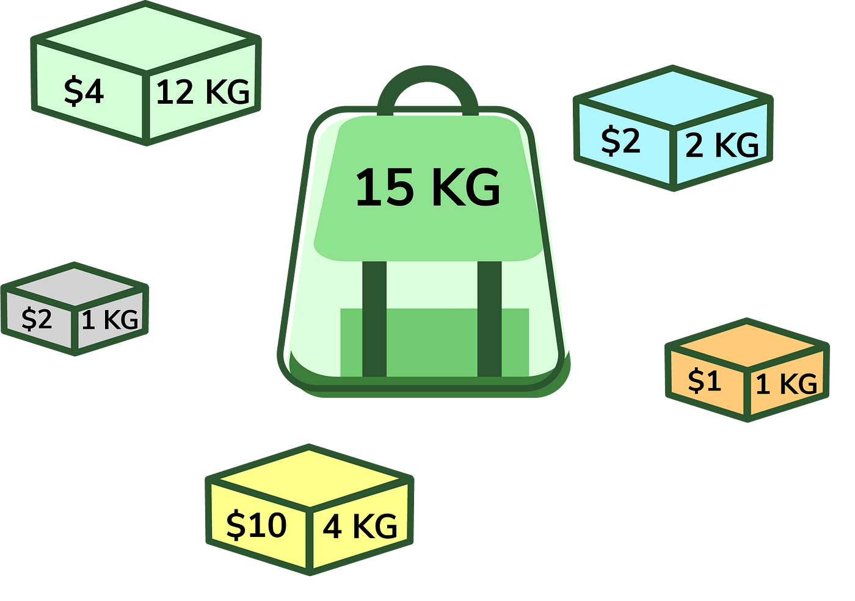
Knapsack Problem
Maximise the value of items packed into a knapsack with a limited capacity C
  You have a set of 𝑛 items, each with:
    A weight 𝑤_{𝑖} (how much it "weighs" or consumes space in the knapsack)
    A profit or value 𝑝_{𝑖} (how much it contributes to the total value when packed)
Unbounded Knapsack Problem
  Unlimited supplies of each type, as long as weight does not exceed capacity C

Slide 4
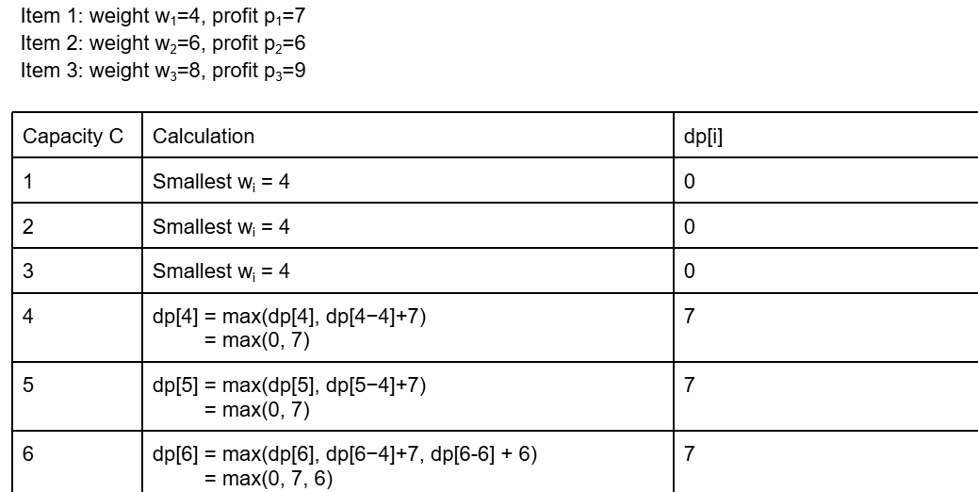
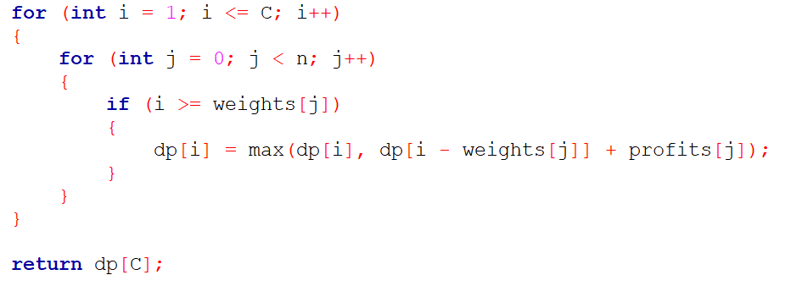
1. Recursive Definition of P(C)
The maximum profit obtainable for a knapsack with capacity C, is based on the choice of whether to include an object type i in the knapsack
Unlimited supplies of each object type → can include an object of type i as many times as the capacity allows

Slide 5
Recursive Formula
For any given capacity C, we have two choices for each item of type i:
Include the item
Add its profit p_{i} to the maximum profit obtainable with the remaining capacity C - w_{i}
Subproblem: P(C - w_{i}) and the profit contributed by including item i is P(C - w_{i}) + p_{i}
2. Skip the item
Profit remains unchanged
To find the optimal solution, take the maximum over all choices
P(C) = max(P(C - w_{i}) + p_{i}) for all i such that w_{i} <= C
The base case will be P(0) = 0
Notes:
Thanks Kai Xin. Now, I'll cover the recursive formula of the algorithm. For any given capacity C , there are 2 choices for each item:
The first option is to include the item and add its profit to our solution. But we need to consider the remaining capacity C - wi. THe total profit then becomes pi + P(C-wi).
The 2nd option is to skip the item and the profit remains unchanged.
To find the optimal solution, we take the maximum value across all these choices
Thus, P(C) = maximum of (P(C-wi) + pi ) for all i while wi is less than or equal to C, and the base case is P(0) = 0.
Now, let me pass the time over to Jun Meng to cover the subproblem graph for P(14)

Slide 6
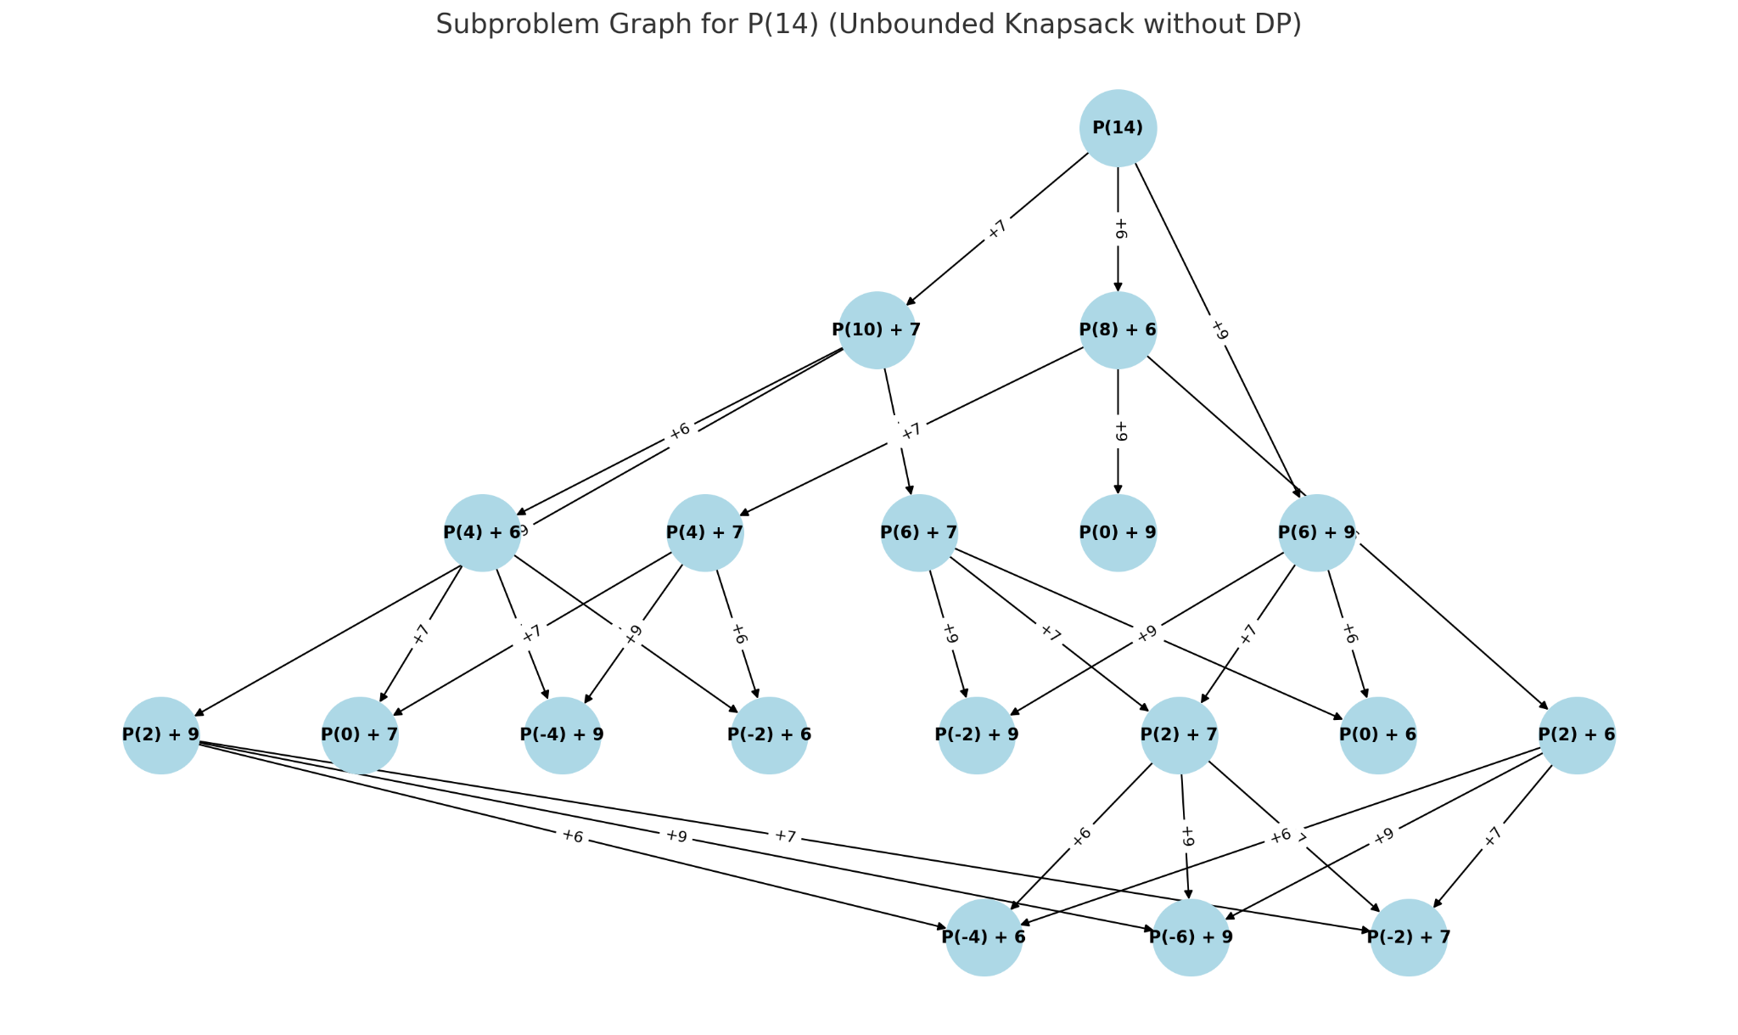
2. Subproblem Graph for P(14)
Capacity C = 14
Weights w = [4, 6, 8]
Profits p = [7, 6, 9]
Notes:
In the problem, we know that the capacity C of the knapsack is 14. The weights are 4, 6, 8 and the profits are 7, 6, 9. The subproblem graph is obtained using matplotlib. In the subproblem graph, each node represents a subproblem, and the number inside the bracket represents the capacity. Starting from the full capacity of 14, we move downward, subtracting weights and adding the corresponding profits. Each arrow between nodes represents a choice of adding a particular item to the knapsack. For eg, if we’re moving from P(14) to P(10), we’re adding corresponding profit 7 and subtracting 4 from the capacity.
These connections allow us to see every possible path to fill the knapsack, with each path representing a different combination of items. By exploring all paths, we identify the maximum profit we can achieve under the constraints.
The subproblem graph, as u can see, grows exponentially as there are paths branching out from each path. There are also multiple repeated subproblems, so if the problem was bigger, the process would be really tedious and computationally inefficient. Hence, there is a need to implement a dynamic programming algorithm, that can store and reuse the solutions to subproblems, thus avoiding redundant calculations.

Slide 7
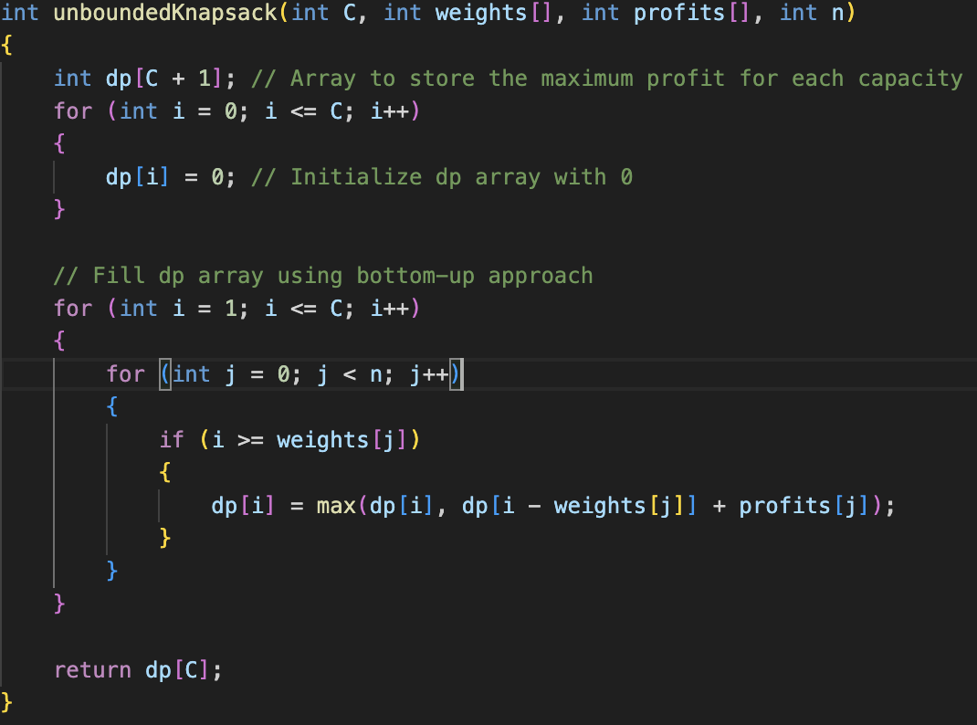
3. Bottom Up Dynamic Programming Algorithm
Notes:
dp [ ] array stores the maximum profit for each knapsack capacity from 0 to C (bottom up approach)
Go from the minimum capacity which is 1 to max which is 14
The outer loop i iterates from 1 to C (max capacity)
The inner loop checks to see if each item j to see if it can fit into the current capacity i
If it fits, find the max profit between including and not including the item i

Slide 8
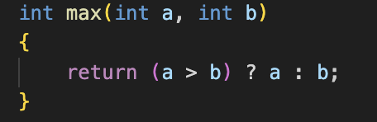
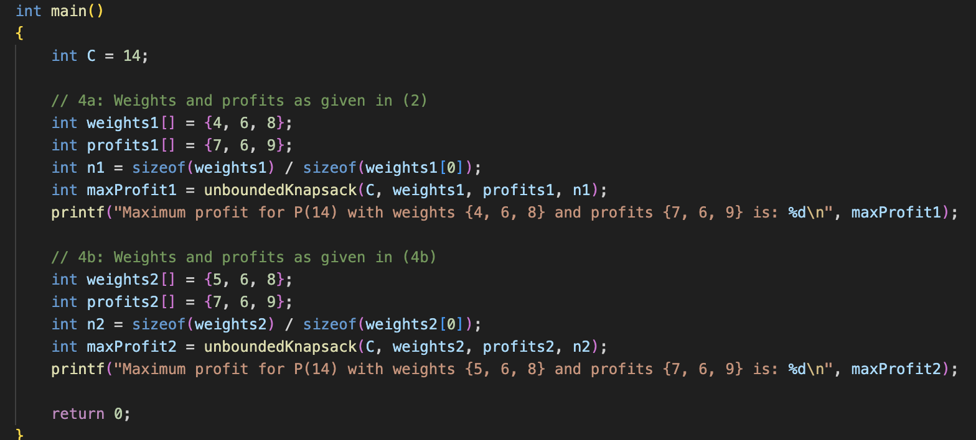
Other Functions
Notes:
This slide contains code for the other functions
Main function: initialises the weights as per question requirement of 4a and 4b
max : returns the maximum of 2 integers

Slide 9
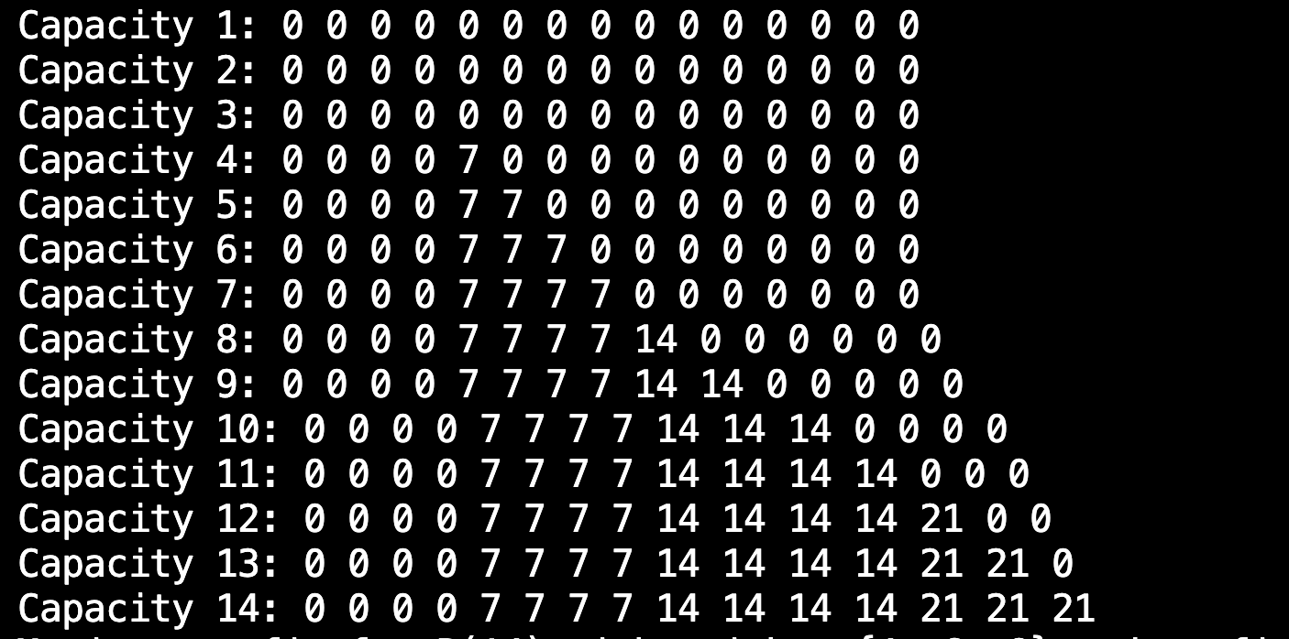
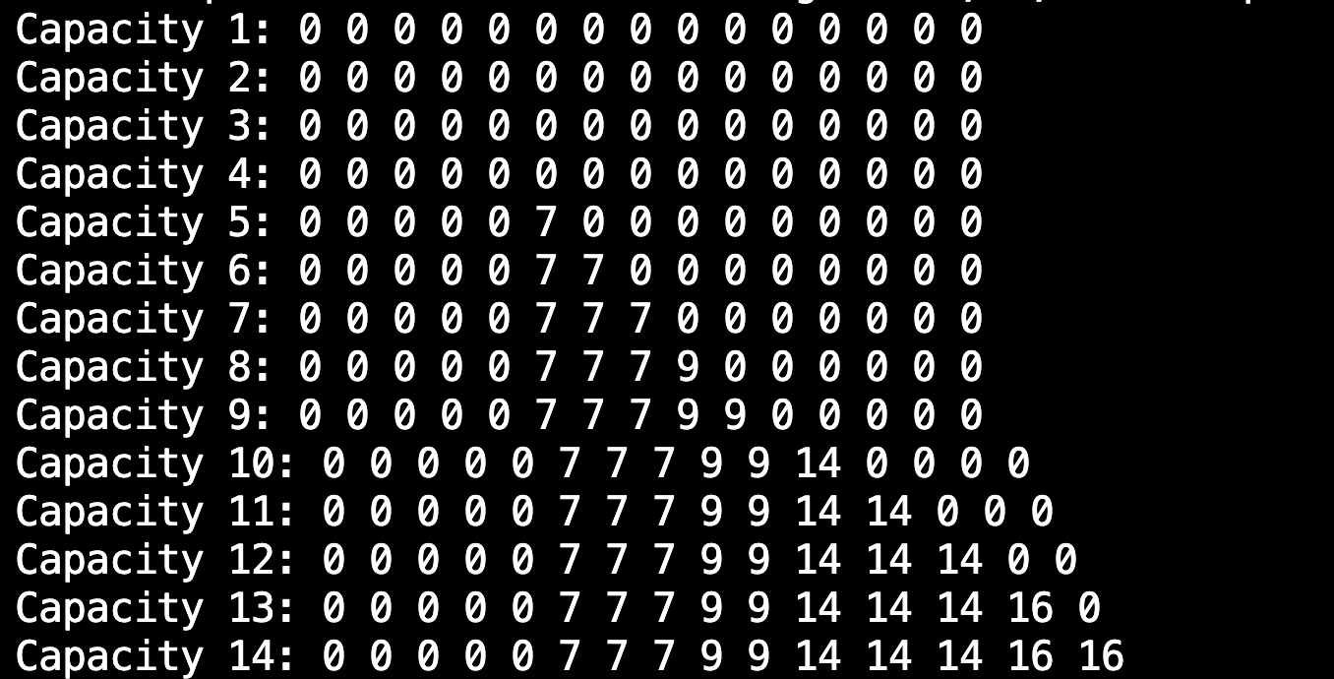
Results
Notes:
This slide shows the running result of P(14) with weights and profits given in part (2) of the assignment pdf and also shows the running result of P(14) with weights and profits given in part (4) of the assignment pdf

Slide 10
Thank you!
Notes:
Thanks TA :D

